Slide 1
SQL PROJECT
MUSIC COMPANY DATA ANALYSIS

Slide 2
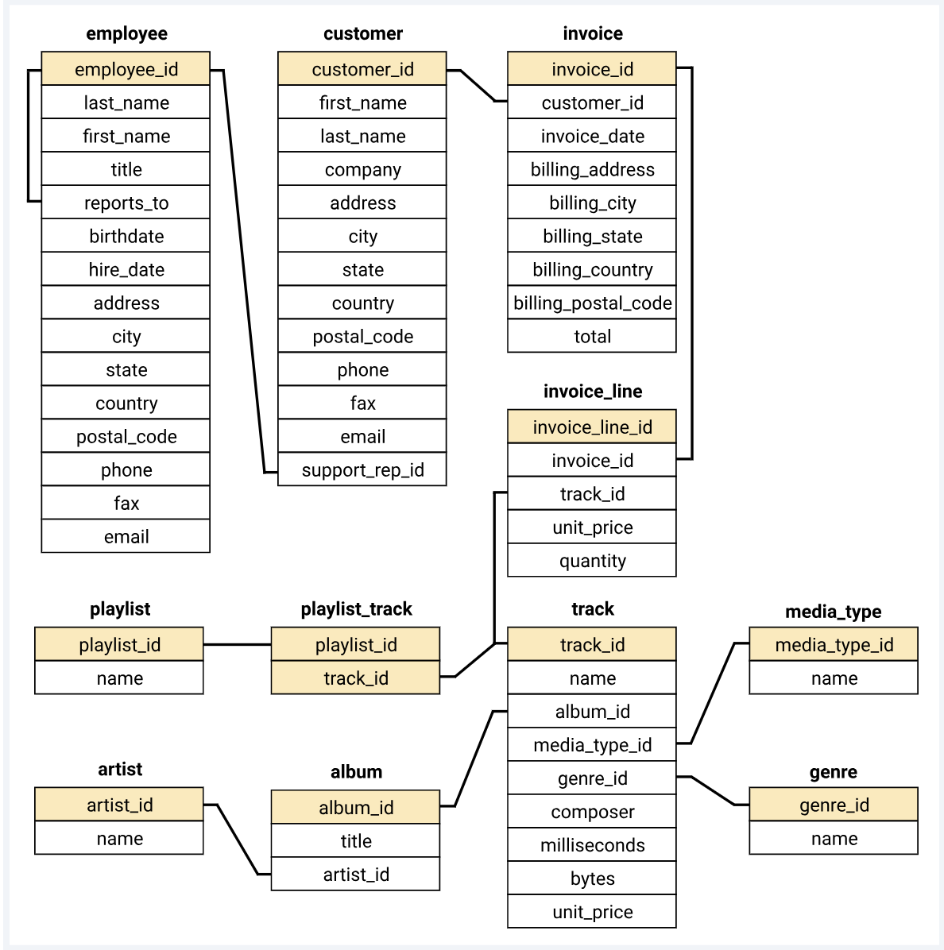
Subtitle

Slide 3
IMPORT DATA SET

Slide 4
Create data base a
Create database music_databse
Use music_databse

Slide 5
Import all the tables which has been presented in schema
Album.csv
Artist.csv
Employee.csv
Customer.csv
Genre.csv
Invoice.csv
Invoice.csv
Invoice_line.csv
Media_type.csv
Playlist.csv
Playlist_track.csv
Track.csv

Slide 6

Go through from every table

Slide 7
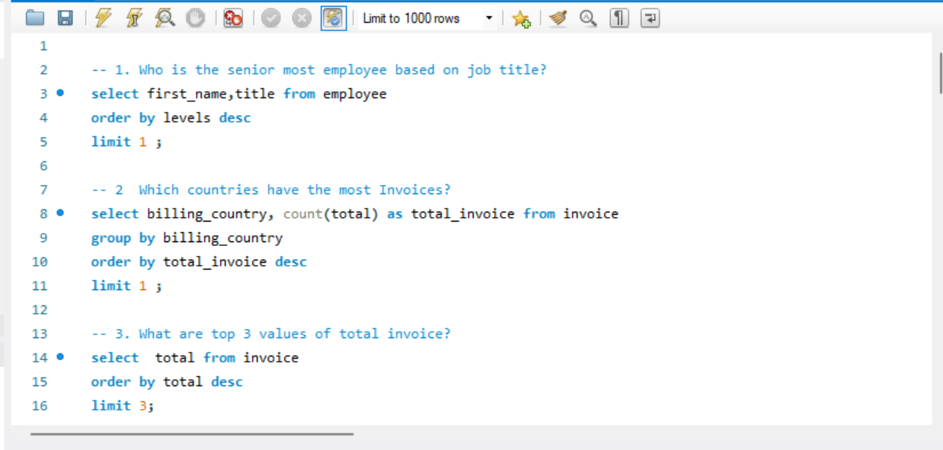
Writing query for phase 1

Slide 8
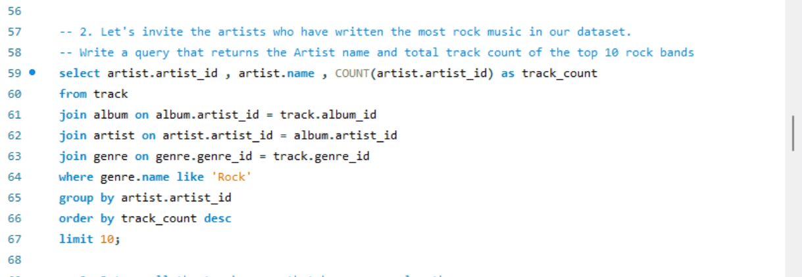
Phase two

Slide 9
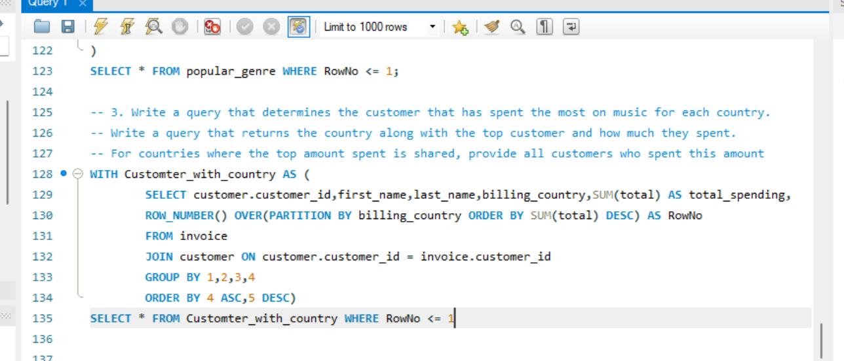
Third phase

Slide 10
“No data is clean but most of it is useful” dean abbott

Slide 11
Thank You

